Slide 1

Library Management System
(LiMS)
Group Number 1
Mentor: Kathiresan N
Capgemini Public
Notes:
Add instructor notes here.

Slide 2
Team Members
Pratik Potdar
Pradnya Shukla
Rahul Vishwakarma
Priyanka Chaudhary
Aditi Dumbre
Naveen Gownivaripalli

Slide 3
Objectives
Project Understanding
Approach used
Project Execution
Modules
Learning
Best Practices
Opportunity for improvement
Demo and Code Walkthrough
Q&A
Notes:
Add instructor notes here.

Slide 4
Project Understanding
This project is aimed at developing Library Management System (LiMS) for the college library.
This is an Intranet based application that can be accessed throughout the campus.
This system can be used to search for books/magazines; reserve books, and issue/return books from the library.
This is an integrated system that contains both the user component and the librarian component.
Notes:
Add instructor notes here.

Slide 5
Approach used :
Front End & Web Components:–
Java Classes coding
Business Logic Components and Services :-
Spring
Application Servers :-
WildFly
Databases:-
Oracle 9i
Notes:
Add the notes here.
Add instructor notes here.

Slide 6
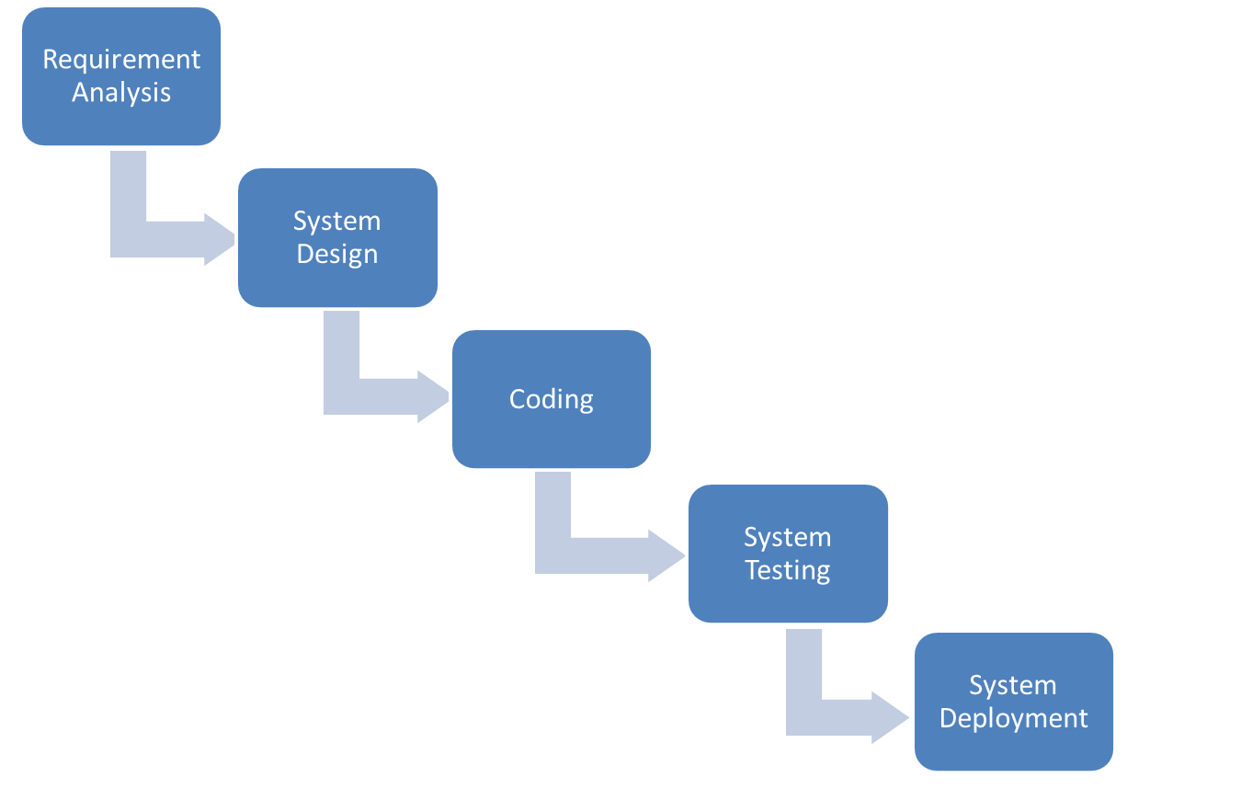
SDLC Model: Waterfall Model

Slide 7

Librarian Module
Add new books
Registration
Login
Remove books
Librarian
Manage return
Manage issue
Notes:
Add instructor notes here.

Slide 8

Student Module
Request Books
Registration
Login
Student
Check Request Status
Notes:
Add instructor notes here.

Slide 9
Modules
Registration (for Librarian and Student)
Login
Add/Remove Books
Manage Return/Issue
Display List of Existing Books
Notes:
Add the notes here.
Add instructor notes here.

Slide 10
Modules
1. Registration:
Registration module is common for all the users of the system
i.e. Librarian & Student. This module will create a new user.
Basic functionality of the login module are as follows:
Take username and password from the user.
After validations ,these will be stored in the users table in database.

Slide 11
Modules
2. LOGIN :
Login module is common for all the users of the system
i.e. Librarian & Student.
Basic functionality of the login module are as follows:
Taking login credentials from the user.
If given credentials are wrong, show appropriate message.
If login succeeds, user will be navigated to his/her respective page as per his/her role.

Slide 12
Modules
3. Add/Remove Books:
This module is for the Librarian to add/remove books which are available for issue.
Basic functionality of this module are as follows:
Adding new books into the inventory.
Removing books from the inventory.
Updating the database accordingly.

Slide 13
Modules
4. Manage Return/Issue:
This module is for the librarian to issue a book to student and also mark the return of the book issued.
Basic functionality of this module are as follows:
    When student requests for a book and if it is available in the inventory then the librarian will issue this book to the student and mark the return date
    The return date & the fine fields are disabled for the student as they would be computed automatically.

Slide 14
Modules
5. Display List of existing Books:
This module displays the available books in book inventory and allows the user/students to place a request for a book.
Basic functionality of this module are as follows:
Display the books available on the screen
Student is requested to enter the book id corresponding to the book required
If the entered book id is present in the database then that book is issued to the student.
If not then proper error message is thrown.

Slide 15
Learning
  1. Technical Learning:
  It lead to learning , implementing and improving the skills related to technical fields such as java 8.0,Spring 4.0,JSP-Servlets.
  As we know that theory unless implemented practically is of no use, so doing such projects also helps in furnishing the technical skills and to work on our weak areas.

Slide 16
Learning(contd..)
  2. Non-Technical Learning:
  It lead to development of several traits that lead to development of skills as:
  Team work: It taught us to work in a team efficiently , communicate with team members efficiently as well as to understand each others aspect efficiently.
  Work in time constraint : It taught us to work for a project/task in a time constraint i.e. to define and schedule our tasks according to time constraint, how to divide the task, etc.

Slide 17
Best Practices
Since Spring 4.0 is used so annotations are used which reduce the compilation errors.
The variables are initialized before they are used.
The for each loop is used for iteration purpose .
The proper naming conventions are used
No Deprecated Method is used
Notes:
Add the notes here.
Add instructor notes here.

Slide 18
Opportunity for improvement
Keeping in view the time constraint provided the project made by our team is lacking with respective to certain aspects which can be further improved
Consolidated Survey Response result could be displayed using graphs and pie charts
Admin module lacks certain functionalities
Notes:
Add the notes here.
Add instructor notes here.

Slide 19
Q & A
Notes:
Add the notes here.
Add instructor notes here.

Slide 20
THANK YOU
Notes:
Add the notes here.
Add instructor notes here.

